Slide 1
PROJECT PROPOSAL KALLIKREIN GENES
Anouk Dupé
Dustin Schilling
David Eckey
Maria Yemane

Slide 2




Agenda
Biological background
01
Data Sets and plot example
02
Milestones
03
Team organization
04

Slide 3
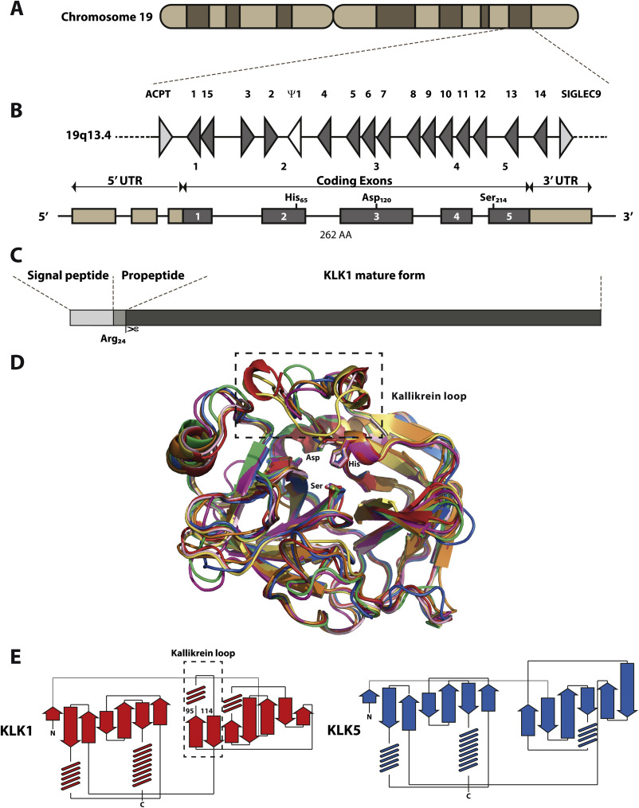
Kallikreins - Introduction
Family of trypsin-like serine proteases
Cluster of 15 genes → Coexpressed
Espression regulateded by steroid hormones
Secreted preoteases
Involved in regulation of blood pressure, tissue remodeling, etc.
Kalinska et al. 2015
Borgono et al. 2004

Slide 4
Kallikreins – Role in Cancer
Expression altered in hormone-related cancer
Up- and Downregulation
hK proteins promote or inhibit cacogenesis
Drug targets
Bio-markes
Borgono et al. 2004

Slide 5
Cancer Data Sets
Small cell lung cancer
(SCLC)
Primary breast cancer
Breast cancer
Tissue sample:
Normal adjacent lung
Tumor SCLC
Mutations:
None, CHEK2, BRCA1 subgroups
Mutations:
Triple Negative, Her2, Luminal A, Luminal B
subgroups

Slide 6
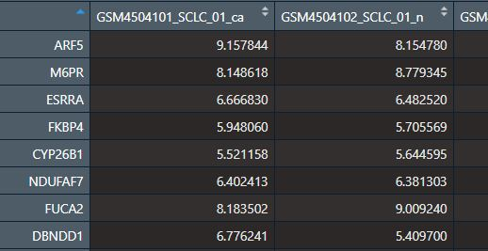
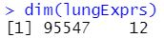
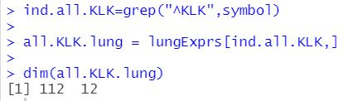
Cancer Data Sets
Small cell lung cancer
(SCLC)
Primary breast cancer
Breast cancer
15 KLK genes with subtypes
112 KLK genes

Slide 7
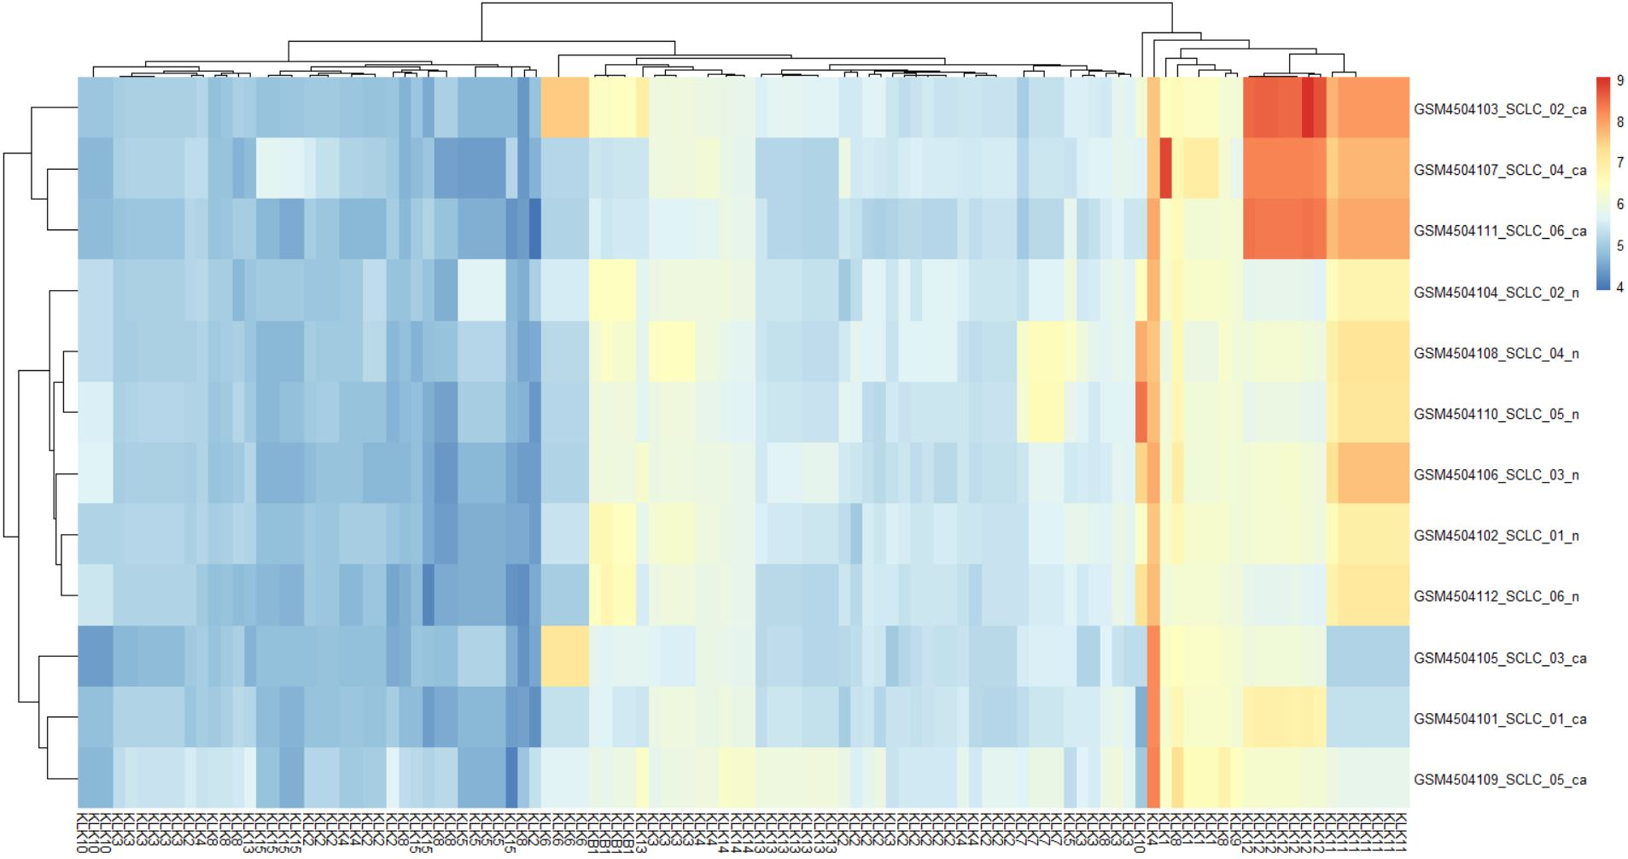
Plot Example – Exploratory Analysis
KLK gene expression in lung cancer and non-cancer tissue
samples
KLK genes

Slide 8
Plot Example – Exploratory Analysis
Cluster??
→ Starting point
for further analysis
KLK gene expression in lung cancer and non-cancer tissue
samples
KLK genes

Slide 9

Main Goal
Being able to determine a specific cancer type by analysing the degree of expression of Kallikrein genes.

Slide 10
Milestones
MILESTONE 01
MILESTONE 03
Is there a significant correlation between Kallikrein expression and tumor presence?
Can we predict the cancer type based on Kallikrein expression?
26.05.21
PCA
MILESTONE 02
Correlation Analysis
What are the main differences in Kallikrein expression in cancer tissue compared to normal tissue?
What are the most up-/down regulated Kallikrein clusters and do they differ in lung cancer compared to breast cancer?
Regression Analysis
12.05.21
17.06.21

Slide 11
Gantt Chart
Apr.
Mai
Juni
Juli
Milestone
15
16
17
18
19
20
21
22
23
24
25
26
27
28
Project start
21.04.2021
Exploratory Analysis
Project proposal
12.05.2021
Correlation Analysis
PCA
Regression Analysis
Final presentation

Slide 12



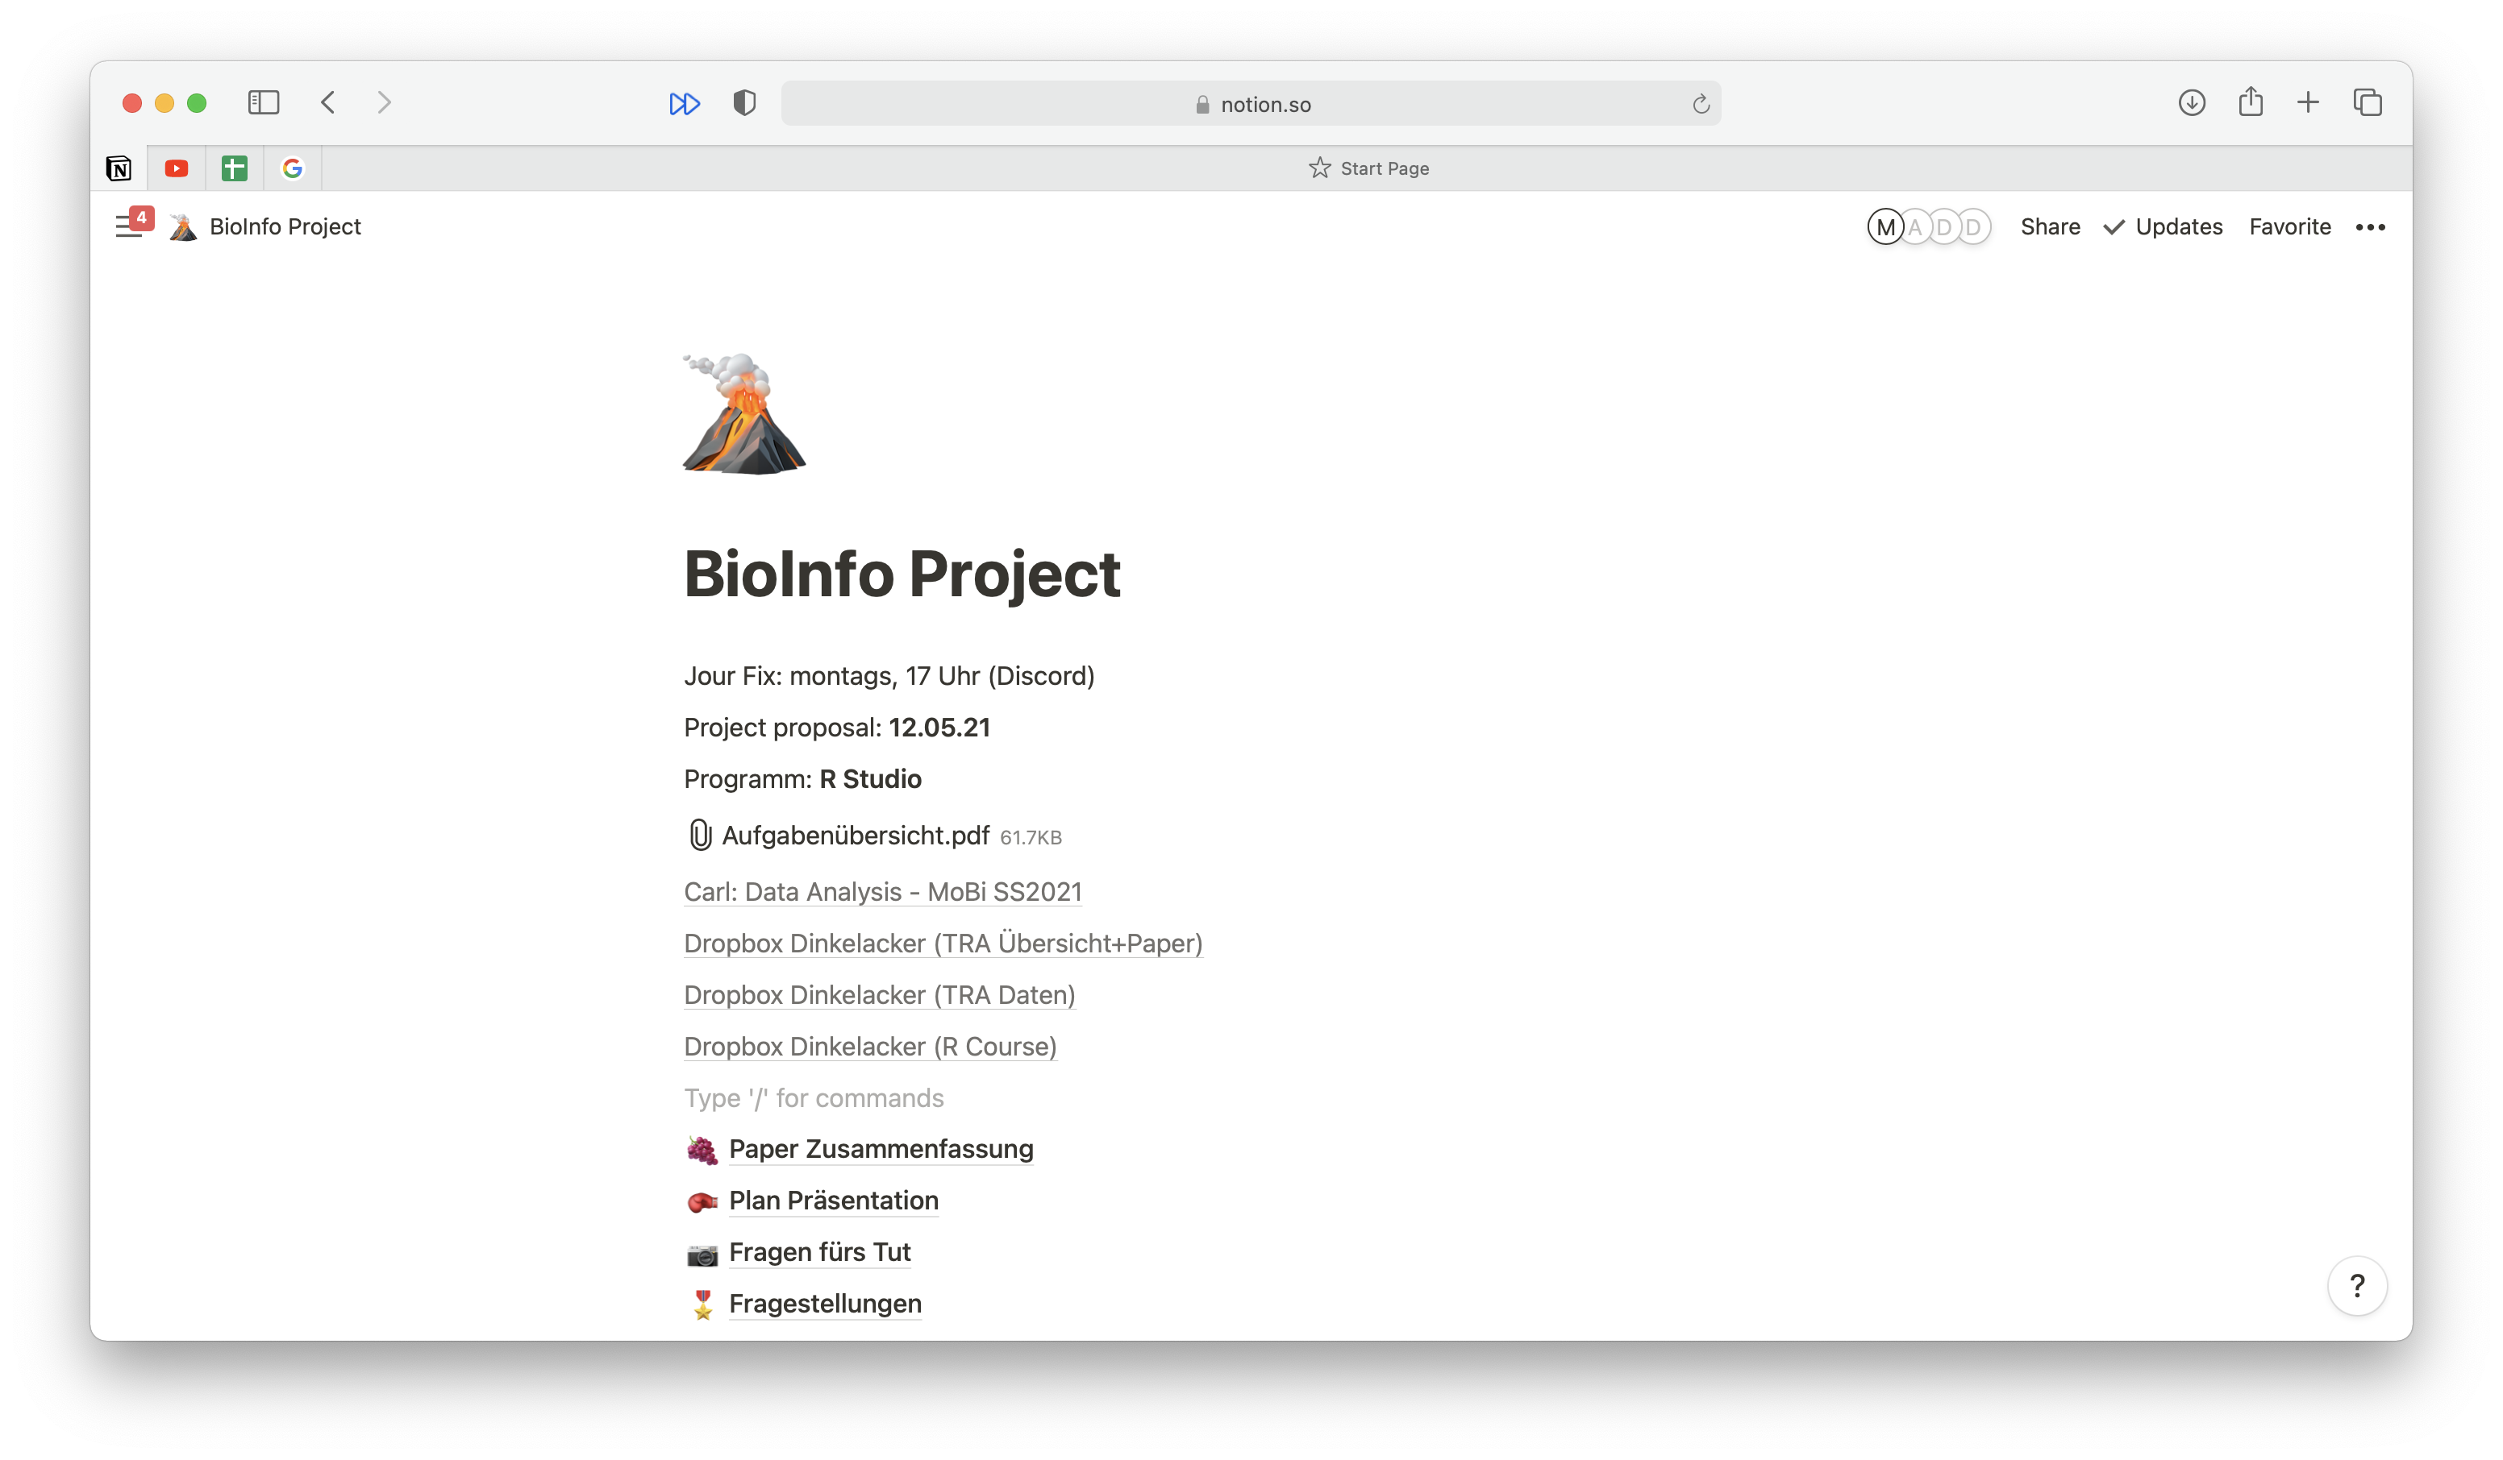


Teamwork aspect
Communication tool:
WhatsApp
Jour Fix: Monday, 5pm
Debrief meeting after tutorial
Calls via Discord
Project manangement tool:
Notion

Slide 13
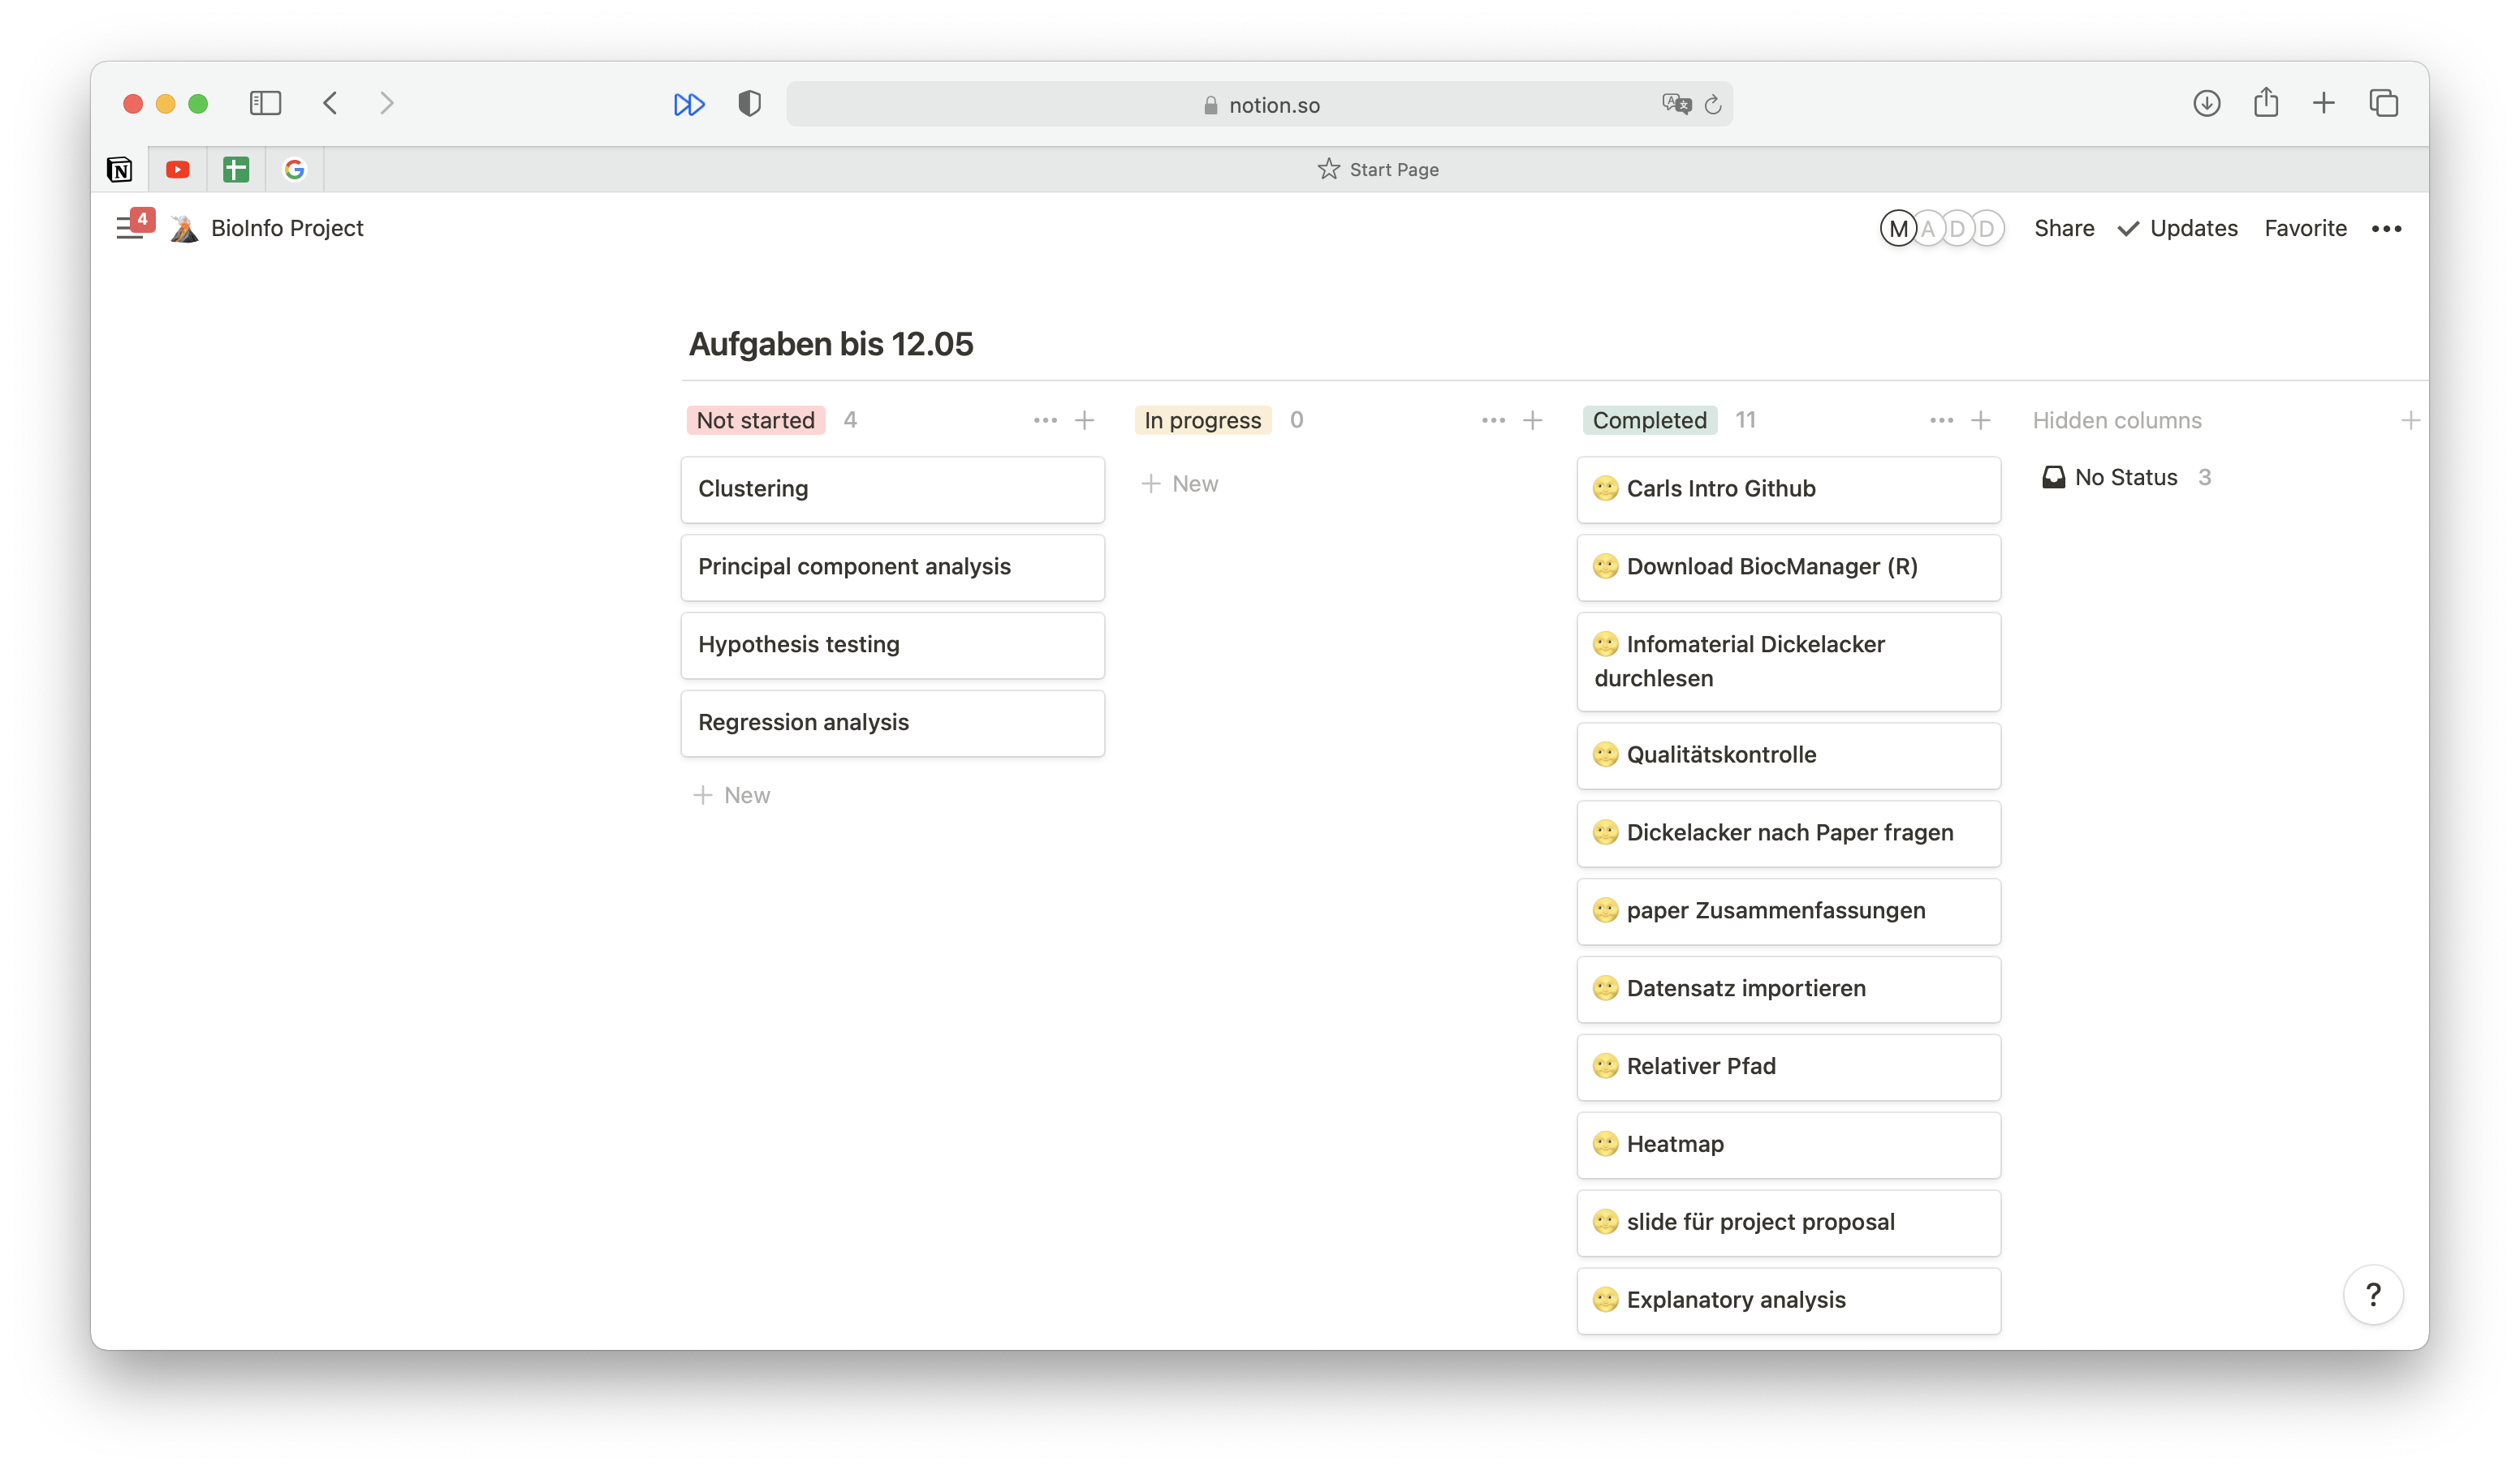
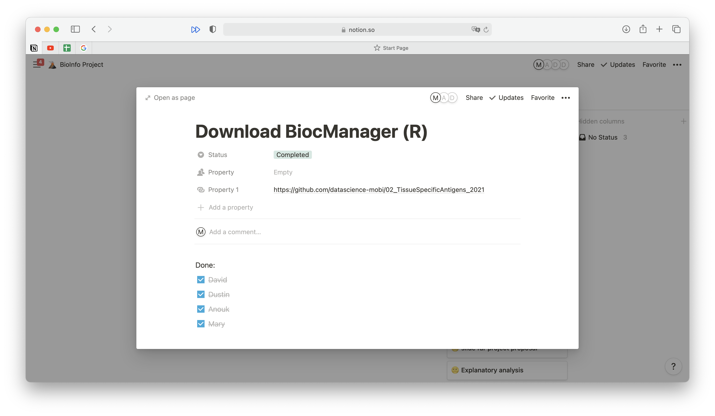
Project management tool
Kanban

Slide 14
QUESTIONS?

Slide 15
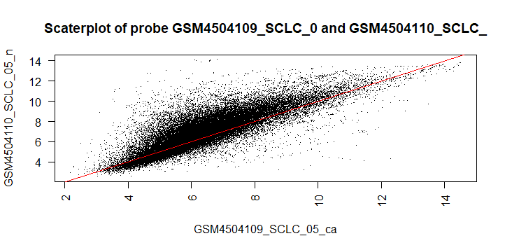
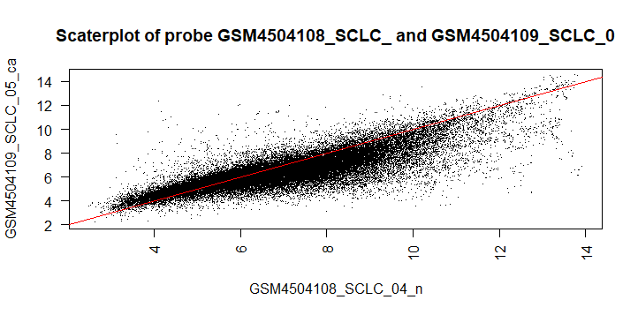
Notes:
Of course every test will be varyfied using hypothesis testing
-> breast cancer expressionn analysis

